Slide 1
Book Recommendation Survey Results
Team AAA Capstone

Slide 2

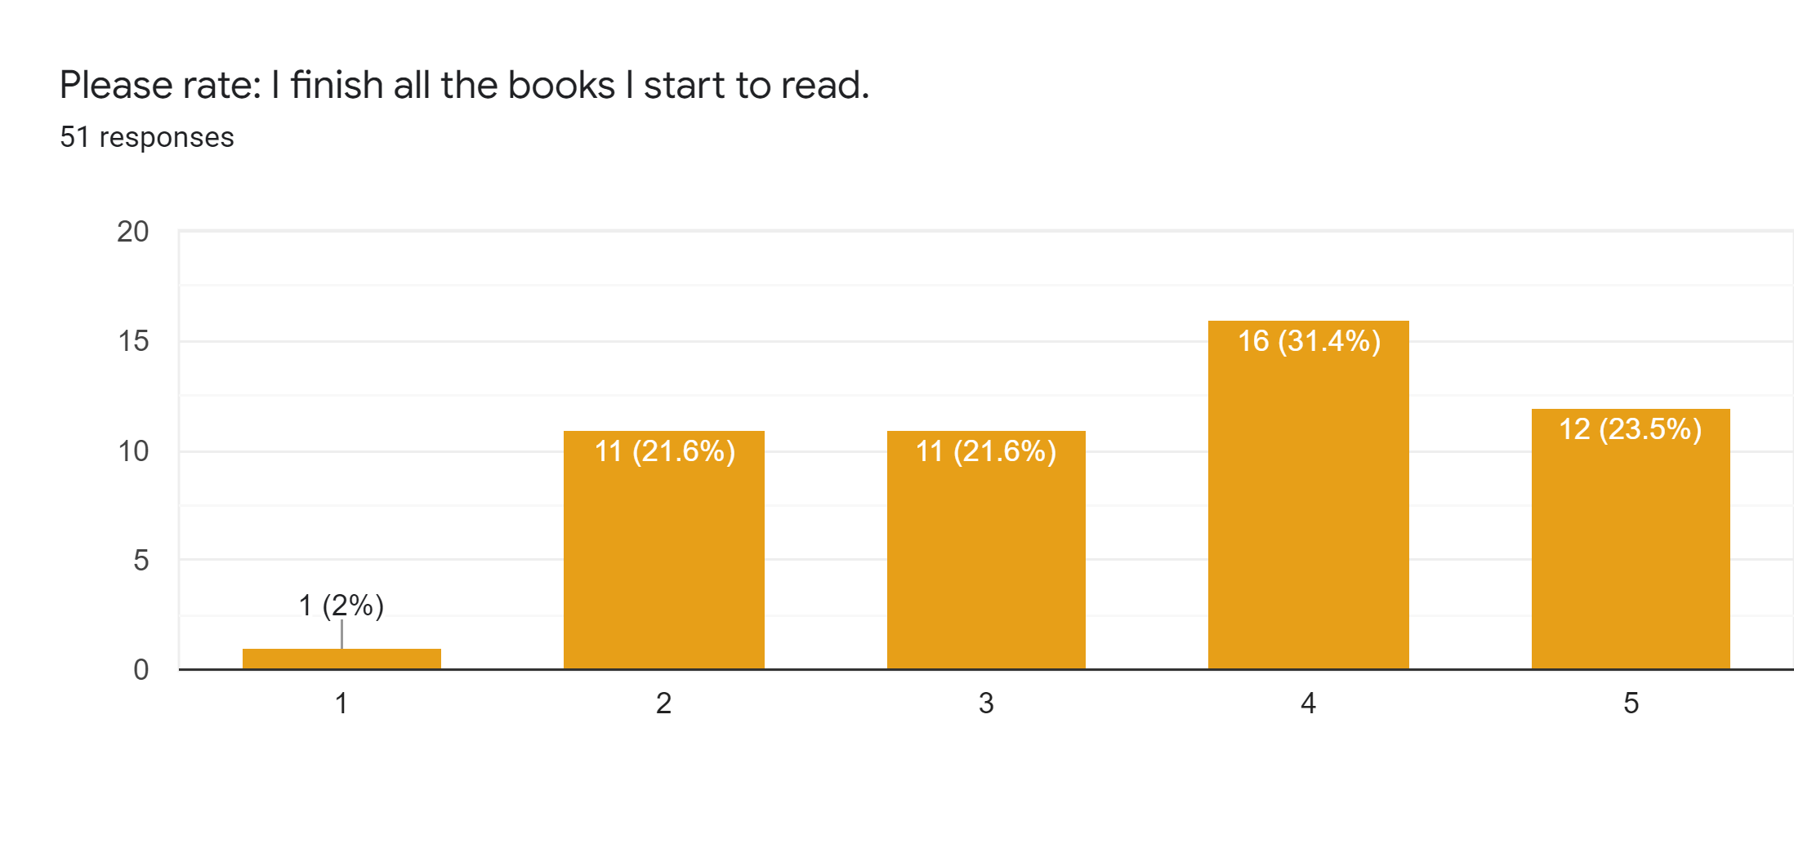
Overall Categorical Results
Most get friend recommendations for new books
Others look online, through Amazon, or at the Library
78.4% are interested in our product
Most find it moderately difficult to find books they can enjoy/relate to

Slide 3

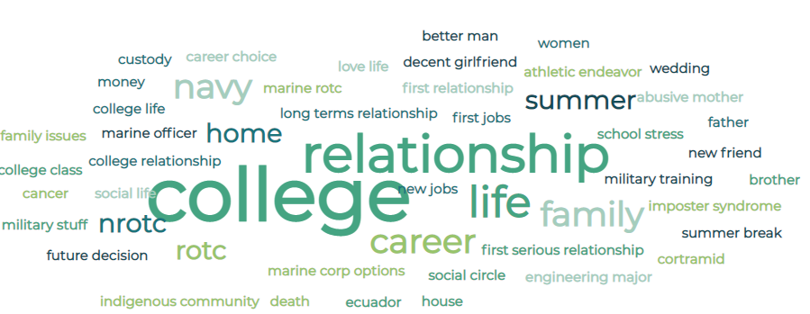

Current Life Events
College – Starting/Coping
Relationships – First/Break-ups
Career – New Job/Life Purpose
Moving – Independence/New
Mental Health – Loneliness, Depression, Stress, etc
Family Issues
Wedding/Death
Military

Slide 4
What Do You Look for in Fiction Books?
Engaging
Good Plot
Mirrors Real Life
Fun to read
Don’t read fiction
Self Discovery
Relatable
Quality of Writing
Compelling
Escapism

